Slide 1

Automated Question Bank Generation System
PBL Review – 2
Student Name: [Your Name] · Roll No: [Your Roll Number] · Dept: Computer Science & Engineering · College: [College Name] · Guide: [Guide Name]

Slide 2

Introduction & Problem Statement
Preparing exam questions manually is time-consuming, repetitive, and error-prone. Teachers need varied questions across topics and difficulty levels, and maintaining large question banks is difficult.
Manual preparation leads to repetition and inconsistent difficulty.
Organizing and searching large banks is inefficient.
Teachers spend significant time creating and curating content.
Our system automates generation from textbooks and PDFs to reduce effort.
Problem Statement
“To develop a system that automatically generates, categorizes, and stores questions from educational content while reducing teacher effort and improving question-bank organization.”

Slide 3

Literature Review — Study 1: NLP-Based Automatic QG
Traditional NLP pipelines extract salient text segments and convert them into questions using rule-based templates and syntactic parsing.
Text
Text processed with tokenization, POS tagging, and dependency parsing.
Keywords and important sentences are identified for QG.
Effective for short factual questions and cloze-style items.
NLP Processing
Important Information
Limitations: grammatical weaknesses, contextual mismatch, and limited difficulty classification.
Generated Question
Diagram: The pipeline shows extraction of key facts via NLP, followed by template-driven question generation and basic post-processing.

Slide 4
Literature Review — Study 2: Transformer / AI-Based QG
Modern transformer models (T5, BART, BERT variants) frame question generation as sequence-to-sequence tasks, producing more context-aware and varied questions.
Educational Text
Learns context and generates multiple question types (fact, why, how).
Better grammar and coherence compared to rule-based systems.
Scales for large corpora and diverse curricula.
Transformer Model
Question Generation
Limitations: large dataset needs, high compute, and the need for human quality checks.
Quality Check
Diagram: A transformer encodes context and decodes question candidates; outputs require filtering, ranking, and human validation for high-stakes use.

Slide 5

Literature Review — Study 3: Online Question Bank Systems
Learning management systems and online banks emphasize storage, retrieval, and test assembly rather than automatic generation.
Questions stored in structured databases with metadata.
Search, tagging, and filtered export for test creation.
Teacher-driven entry and manual curation remain common.
Teacher
Database
Test
Limitations: reliance on manual input; limited automatic generation and difficulty estimation.
Question Entry
Search/Filter
Diagram: Emphasizes management and retrieval capabilities but limited automation in content creation.

Slide 6

Comparison of Existing Studies
Compact comparison highlights strengths and weaknesses across three solution categories.
Feature
NLP-Based
Transformer-Based
Online Q Bank
Automatic Generation
Yes
Yes
Limited/No
NLP Processing
Yes
Yes
Limited
Context Understanding
Medium
High
Low
Topic Classification
Limited
Possible
Usually Manual
Difficulty Estimation
Limited
Possible
Usually Manual
Question Storage
Basic
Depends
Yes
Search & Filter
Limited
Depends
Yes
Computational Cost
Low/Medium
High
Low
Main observation: a unified system combining generation, classification, difficulty estimation, storage, and export remains an open need.

Slide 7
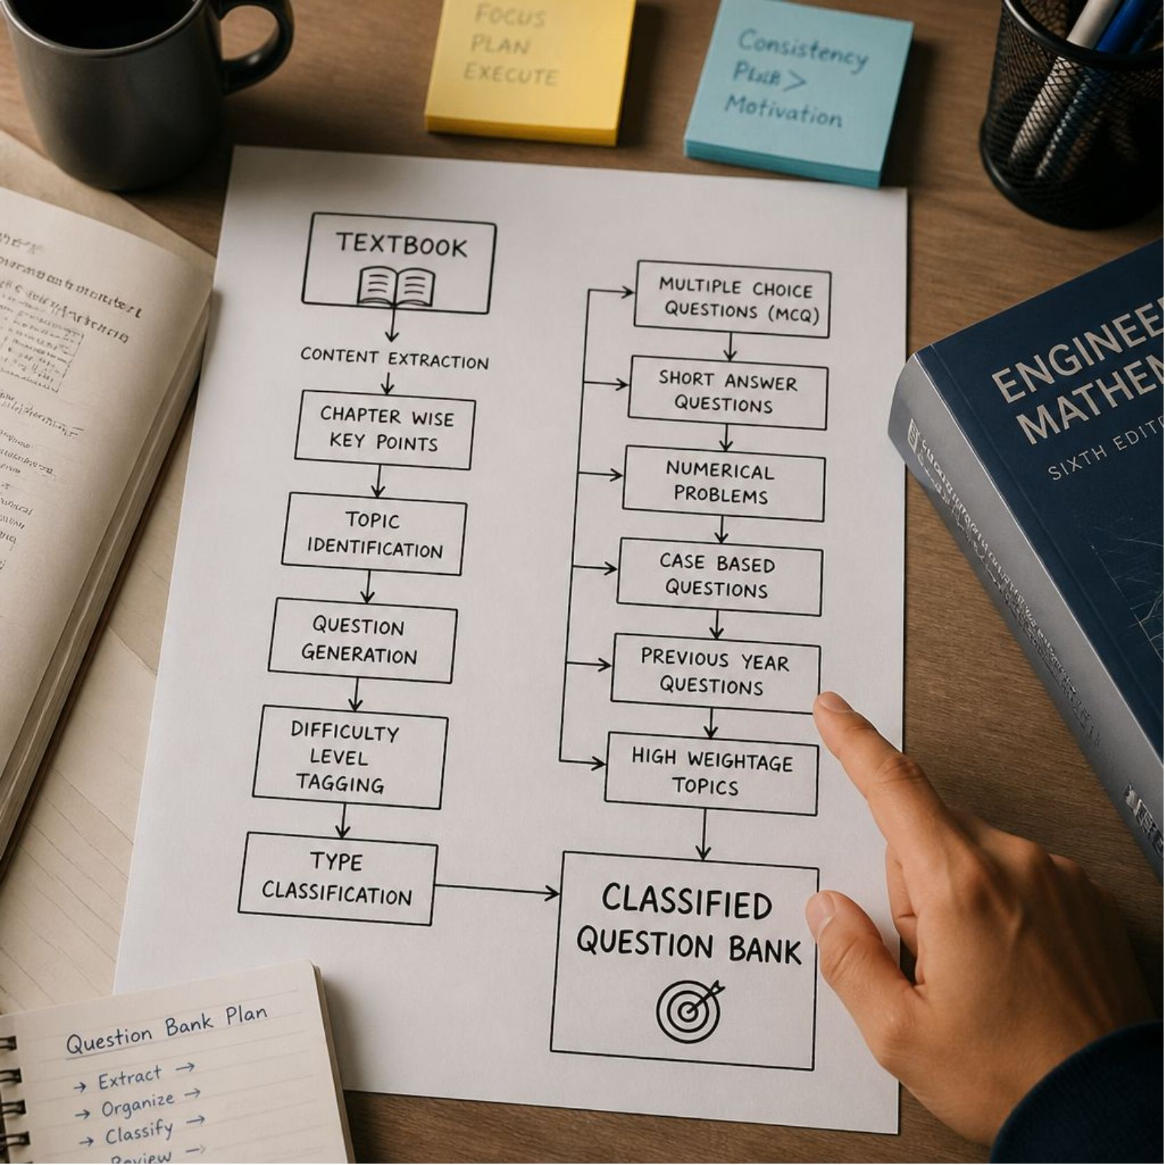
Gap Analysis — What’s Missing
Key gaps identified from literature and existing platforms:
Automatic topic-wise organization is often absent.
Difficulty estimation and quality scoring are limited.
Duplicate or low-quality questions are generated without filtering.
High computational needs for advanced AI solutions.
Search/export UX for teachers can be improved.
Proposed Gap Solution (Main Contribution)
Textbook/PDF → Text Processing → Keyword Extraction → Topic Classification → Question Generation → Difficulty Estimation → Database → Search/Filter/Export.

Slide 8


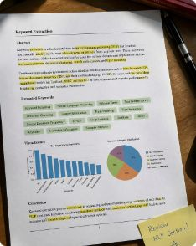


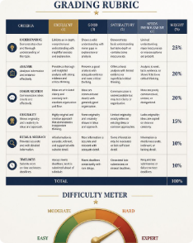

Proposed System & Methodology
The system ingests textbooks and PDFs, extracts and preprocesses text, classifies content by topic, generates question candidates, estimates difficulty, and stores structured questions with metadata in SQLite for retrieval and export.
1. Upload
2. Text Processing
3. Keyword Extraction
4. Topic Classification
Upload textbook or PDF as input document.
OCR (if needed), cleaning, sentence segmentation.
spaCy/NLTK extract key phrases and concepts.
Map sentences to course topics using trained classifiers.
5. Question Generation
6. Difficulty Estimation
7. Storage & Export
Template + Transformer hybrid generates question candidates.
Heuristic and ML-based scoring to tag difficulty levels.
Store structured questions in SQLite; support search and export (CSV/JSON).
Technologies: Python/Java, spaCy, NLTK, SQLite, optional Flask/Django for UI and REST API for integration.

Slide 9

Conclusion & Future Scope
Conclusion: The proposed system reduces manual effort, extracts useful items from textbooks/PDFs, organizes questions by topic and difficulty, and enables fast retrieval for tests and practice sets.
Improves teacher efficiency and consistency in assessment content.
Provides structured metadata for search, filtering, and export.
Hybrid generation (rules + transformers) balances quality and compute cost.
Future Scope
Integrate transformer-based Q&A generation with quality-ranking models.
Multi-language support and OCR improvements.
Cloud-based storage and collaborative authoring tools.
ML models for automated difficulty and quality prediction.
Integration with LMS via REST APIs for seamless export/import.

Slide 10
References
1. Heilman, M., & Smith, N. A., “Good Question! Statistical Ranking for Question Generation,” NAACL, 2010.
2. Du, X., Shao, J., & Cardie, C., “Learning to Ask: Neural Question Generation for Reading Comprehension,” ACL, 2017.
3. Wang, L., & Wan, X., “A Reinforced Topic-Aware Neural Question Generation,” EMNLP, 2018.
4. spaCy documentation — https://spacy.io/ (accessed 2026)
5. NLTK documentation — https://www.nltk.org/ (accessed 2026)
6. SQLite documentation — https://www.sqlite.org/docs.html (accessed 2026)
Thank You
Questions & Answers

